Slide 1
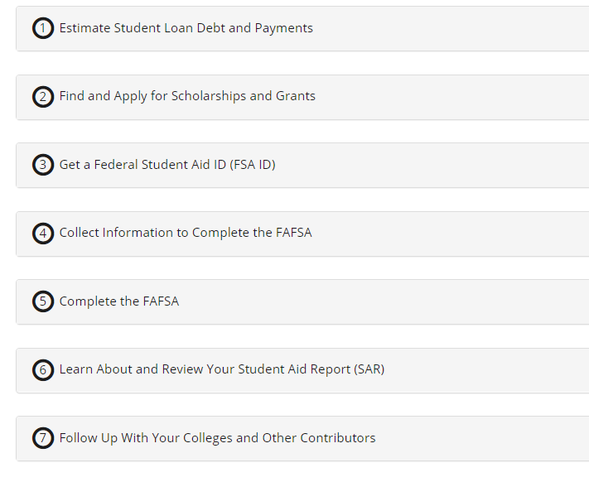
Let us walk you through the FAFSA
https://al.kuder.com to get started today!

Slide 2
Log in to The Alabama Career Planning System
https://al.kuder.com
Click the Blue “Log in with Clever” Button
Students:
School Username & Password
Need Help? Clientengagement@kuder.com
877-999-6227
Or contact your teacher/school counselor

Slide 3
Inicie sesión en el Sistema de Planificación de Carrera de Alabama
https://al.kuder.com
Haga clic en el botón azul "Iniciar sesión con inteligencia”
Estudiantes:
-Nombre de usuario y contraseña de la escuela
¿ Necesitas ayuda? Clientengagement@kuder.com
877-999-6227
O contacta a tu maestro / consejero escolar

Slide 4
Logging into kuder without clever
https://al.kuder.com
Click the Green Log in Button
Enter your Kuder username/password
Don’t know your log in? Clientengagement@kuder.com

Slide 5
Iniciar sesión en kuder sin inteligencia
https://al.kuder.com
Haga clic en el botón verde Iniciar sesión.
Ingrese su nombre de usuario / contraseña de Kuder
¿No conoces tu inicio de sesión? Clientengagement@kuder.com

Slide 6
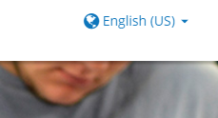
Estudiantes de habla hispana y familias
Spanish Speaking Students & Families
Translate the log in screen by clicking “English”
After you log in, translate to Spanish by clicking “English”
1. Ve a https://al.kuder.com
2. Traduzca la pantalla de inicio de sesión hacendo clic en "Inglés"
3. Después de iniciar sesión, traduzca al español haciendo clic en "Inglés"

Slide 7
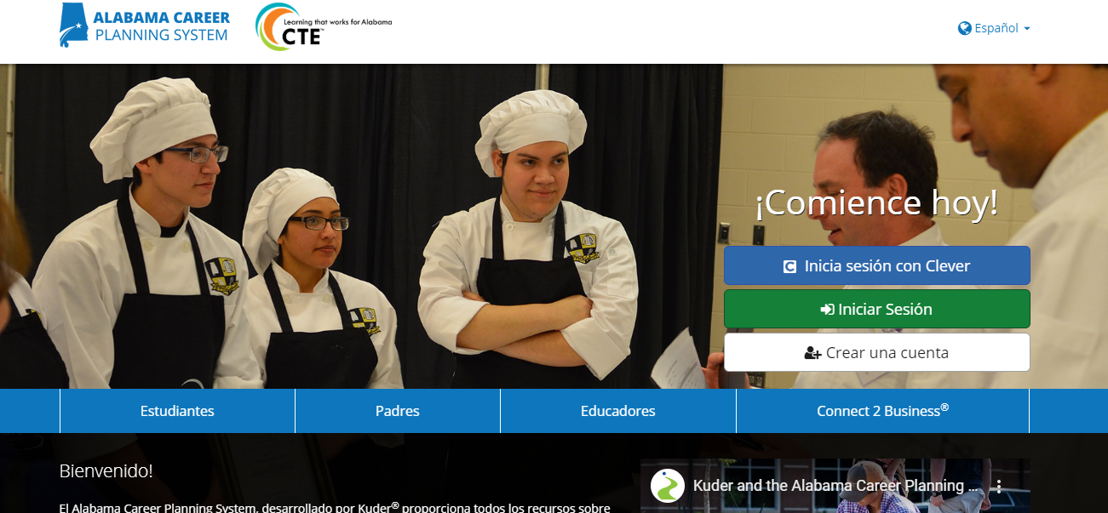
Traducir al español

Slide 8
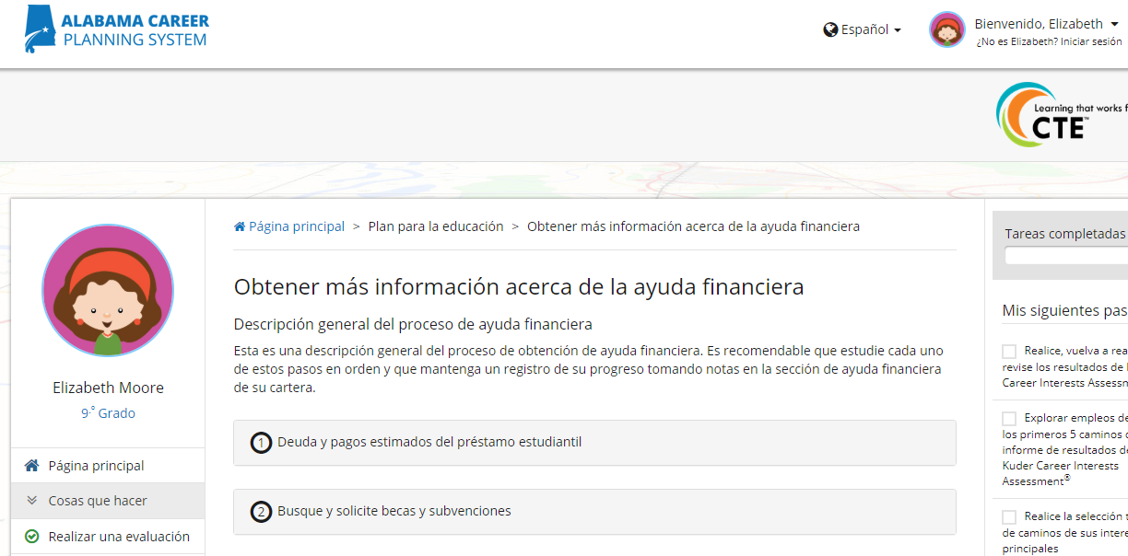
Traducir al español

Slide 9
Once you are logged in
On the left hand side of your screen, click
-Plan for Education.
2. You will see tools for:
Learn about Financial Aid (this is for FAFSA)
Scholarships
Find Colleges & College Match

Slide 10
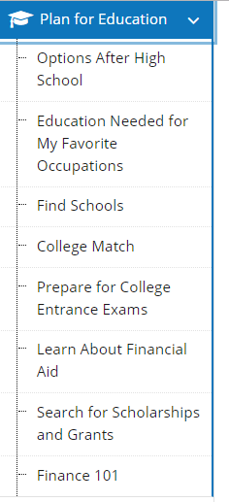
Complete the Fafsa
You will follow steps #3-5 to complete your FAFSA

Slide 11
3. Get a Federal Student Aid ID

Slide 12
4. Collect Info to Complete the FAFSA

Slide 13
5. Complete the FAFSA
https://studentaid.ed.gov/sa/fafsa

Slide 14
6. Review your Student Aid Report

Slide 15
7. Follow up with Schools/Colleges
Follow up with:
Phone Call
Email
Head to the School’s Financial Aid office

Slide 16
Sources for College Funding
Pell Grants
Scholarships
Institutional & In-State Grants
Federal Student Loans
Private Loans
Use the Kuder system to find out today which schools are likely to offer your family these funds!
Log into your student account.
Click Plan for Education tab (left hand side).
Click College Match.
Enter your information (see next screens).

Slide 17
Enter College Match Criteria

Slide 18
Enter Financial & Academic Info
No EFC is needed to complete College Match

Slide 19
College Match Results
Your “match” is based on how likely you are to be accepted to each college.
Click on the name of each college to see more info.

Slide 20
How much will each college cost for your family?

Slide 21
See the costs for each school Find out average grant & loan amounts

Slide 22
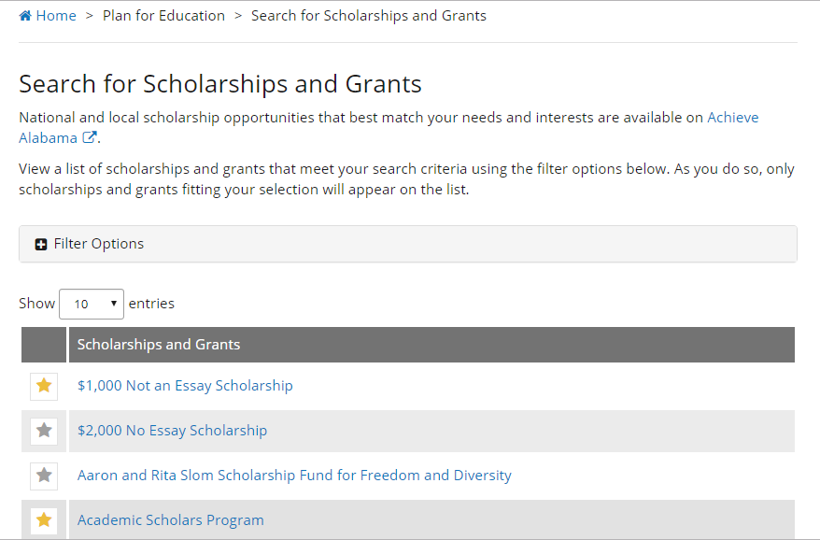
Scholarship Search
Create your free account with Achieve Alabama to look for in-state scholarships!
Hint: Use Filter Options to search.

Slide 23
Need help? We are here!
https://al.kuder.com
Clientengagement@kuder.com
Call us!
877-999-6227
Contact your Teacher, Career Coach, or School Counselor

Slide 24
Gina Maxwell __________ Career Coach
gmaxwell@pikecountyschools.com
maxwellg@troyschools.net

